Slide 1
Networking and Networking Devices
Data Center networking is the process of establishing and interconnecting the entire physical and network-based devices and equipment within a data center facility.
Networking enables digital connection between data center infrastructure nodes and equipment to ensure that they communicate and transfer data between each other internally as well as externally.
Data Center networking creates a network infrastructure that should be reliable ,secure, stable and scalable to meet the network requirements in peak utilization.

Slide 2
Networking and Networking Devices
Components and Technology that makes Data Center Networking are
Networking equipment (routers, switches, hubs, etc.)
Network cabling (LAN/WAN and network interface cabling)
Network addressing scheme such as IP V4 or IP V6
Network security (security protocols/encryption algorithms, firewalls, IDS)
Internet connectivity (satellite, DSL, wireless, optical)

Slide 3
Networking and Networking Devices
Routers :
It’s a device which is used for data packet communication inside a network between two LAN/WAN.
Router performs the routing of the data from source to destination network address.
Router reads the network address of the data packet and determines its destination using information stored under routing table and routing policy.
Routing table consist of information like Network ID ,Metric ,Next hop.
Best example of router is our DSL router we use for connecting to internet through our service provider. It comes under internet layer of TCP/IP model.

Slide 4
Networking and Networking Devices
Routing table looks something like
Network Destination | Netmask | Gateway | Interface | Metric
0.0.0.0 | 0.0.0.0 | 192.168.0.1 | 192.168.0.100 | 10
127.0.0.0 | 255.0.0.0 | 127.0.0.1 | 127.0.0.1 | 1

Slide 5
Networking and Networking Devices
Switches:
Switch is device that is used for connecting devices on network.
It is suppose to perform the function of receiving the information from the source and then sending to the appropriate destination.
Switches operate under the Data Link layer of the OSI model
Switches are similar to routers however they are limited within the same network unlike routers.
Switches can be managed and unmanaged type.

Slide 6
Networking and Networking Devices
Hubs:
Hubs is the most basic networking device that connects multiple computers or other network devices together. It works in layer 1 of the OSI model.
Hubs don’t have Network table and instead they broadcast the data across each connection.
Hubs do detect network collision however they can still cause bottlenecks.
Hubs were preferred over network switches and routers due to the cost.
USB hub is an example which helps connecting multiple USB to a single computer.

Slide 7
Networking and Networking Devices
Local Area Network (LAN):
It’s a computer network that interconnects computers within a limited area like office ,school ,residence etc.
A local area network may serve as few as two or three users (for example, in a small-office network) or several hundred users in a larger office.
LAN networking comprises cables, switches, routers and other components that let users connect to internal servers, websites and other LANs via wide area networks.
Wifi is one of the ways of enabling LAN connections.

Slide 8
Networking and Networking Devices
Wide Area Network (WAN) :
It’s a computer network that interconnects computers that are far apart. It covers large Geographical distance compared to LAN.
WAN connects different small networks which includes LAN hence ensuring a connection of users and computers connection from one location to different other locations.
WAN can be build over private network or on leased telecommunication lines.
Banking system is one of the examples of WAN where multiple branches are connected with each other to share and access a common data.

Slide 9
Network Management and Optimization
Network management is defined as the process of managing a network for fault and performance using various tools and technologies to keep up with the business requirements.
Network Management is a mechanism that helps in administration and managing network devices.
Objective of Network management is to achieve an error free network
Key aspects to Network management are
Fault Identification
Performance Management
Network Provisioning
Maintaining QoS

Slide 10
Network Management and Optimization
Fault Identification :
The biggest challenge with today's network management solutions, is to proactively identify faults before it impacts end-users.
Organizations need to deploy Network Management software which should perform
Performance threshold metrics
Proactively notify for threshold through alert generated emails
Automatically log incidents for Network team to work on alerts related to networking components.

Slide 11
Network Management and Optimization
Performance Management :
This is the ideal way of finding out the performance of your network device and hence complete network infrastructure.
It involves troubleshooting faults either through a manual or automated approach so that the performance of the network is restored to its original or improved condition
Network Provisioning :
Network provisioning involves calculating the load handled by the network and future demands based on the current network trend
It also involves keeping resources in reserve so that when a need arises, it becomes easier to handle.

Slide 12
Network Management and Optimization
Maintaining Quality Of Service :
Service quality is a very important factor in Network environment. Its very common with time network performance degrade and hence its very essential to maintain that quality.
Its very essential to meet SLA and hence adhere to service level agreements and achieve 99.9% availability to network and business critical applications.

Slide 13
Network Management and Optimization
Network Optimization:
Network optimization is technology used for improving network performance for a given environment.
The goal of any network optimization is with the given set of constraints; ensuring an optimal network design with lowest cost structure and free flow of data
Network optimization should be able to ensure optimal usage for system resources, improve productivity as well as efficiency for the organization.
Benefits it serves are faster transfer of data ,disaster recovery capabilities ,reducing bandwidth expenses and also improves performance of the applications.

Slide 14
Network Security
Network Security is term that helps in describing the rules and policies that implemented by a network administrator in order to avoid and block any unauthorized access , exploitation, modification, or denial of the network and network resources.
The first layer of network security is enforced through a username/password mechanism, which only allows access to authenticated users with customized privileges
When a user is authenticated and granted specific system access, the configured firewall enforces network policies, that is, accessible user services.
Network security are of various types and may vary depending upon network administrators and level of security.

Slide 15
Network Security
Types of Network Security
Antivirus and Antimalware Software :
Software is used for protecting against malware, which includes spyware, ransomware, Trojans, worms, and viruses.
This software handles this threat by scanning for malware entry and regularly tracks files afterward in order to detect anomalies, remove malware, and fix damage.
Behavioral Analytics :
In order to detect abnormal network behavior, you will have to know what normal behavior looks like.
Behavioral analytics tools are capable of automatically discerning activities that deviate from the norm.
Security team will thus be able to efficiently detect indicators of compromise that pose a potential problem and rapidly remediate threats.

Slide 16
Network Security
Data Loss Prevention (DLP) :
DLP technologies, network security measures, help prevent people from uploading, forwarding, or even printing vital information in an unsafe manner.
Organizations have to make sure that they set security policy to prevent sending any sensitive information outside organization.
Email Security
An email security is capable of blocking incoming attacks and controlling outbound messages in order to prevent the loss of sensitive data.
Email gateways are considered to be the number one threat for security breach.

Slide 17
Network Security
Firewalls:
Firewall works as a gate between trusted internal network and untrusted outside network like internet.
Firewall monitors all the traffic flowing in/out of our client PC to untrusted network and secures all connections when you are online.
Its generally a set of rules employed to allow/block traffic.
Simple example of firewall rule is allowing port 443 from client internal network to outside for accessing web requests.

Slide 18
Network Security
Virtual Private Network (VPN)
A VPN is another type of network security capable of encrypting the connection from an endpoint to a network, mostly over the Internet
People who are officially working over internet and wants to connect to organization network use VPN which helps in encrypting and securing the connection to their organization premises and thus avoids any security breach.
Web Security
Web security helps restrict staff access to the websites present over internet.
It helps in denying access to any malicious websites and enhance the security of organization

Slide 19
Dynamic Host Control Protocol
Dynamic Host Configuration Protocol (DHCP) is a protocol for assigning dynamic IP addresses to devices on a network. With dynamic addressing.
A device may get assigned with different IP every time it connects to the network.
DHCP also helps in providing the static IP addresses to the device through reservation.
Dynamic addressing simplifies network administration because the software keeps track of IP addresses rather than requiring an administrator to manage the task.
A computer object can be added to the network and will be assigned the IP automatically through DHCP rather than manually doing the task.

Slide 20
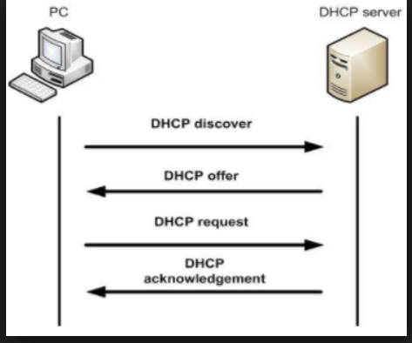
Dynamic Host Control Protocol
The Process of DHCP can be described as below
DHCP client sends a DHCPdiscover message on the network
When DHCP server receives the DHCPdiscover message it offers the
Client by reserving IP against the client through DHCPoffer message.
Client then sends DHCPrequest message to DHCP server requesting
for the offered IP from DHCP server.
When DHCP server recieves the DHCPrequest from client it acknowledge
the client request by sending DHCPack packet to the client and reserving
the IP address against the client.

Slide 21
Dynamic Host Control Protocol
DHCP has the ability of reserving the IP range under network for static IP allocation to critical devices and servers.
DHCP offer IP lease for 8 days to particular client if the IP allocation is not renewed from the client end.
In absence of DHCP an administrator has to manually assign IP address to the devices which is a tedious job.

Slide 22
Domain Name System
DNS or Domain name system translates the machine IP address into Name which can be easily readable and can be easily memorized.
Example its hard to remember 176.32.98.166 and easy to browse www.amazon.com ,hence DNS resolves IP Address to a name and vice versa.
Every domain have their own authoritative DNS server which helps in resolving the DNS request made from the DNS Client.
Only authoritative DNS server has the rights to give answers to the DNS Query made from the client.
Domain name resolvers determine the domain name servers responsible for the domain name in question by a sequence of queries starting with the right-most (top-level) domain label

Slide 23
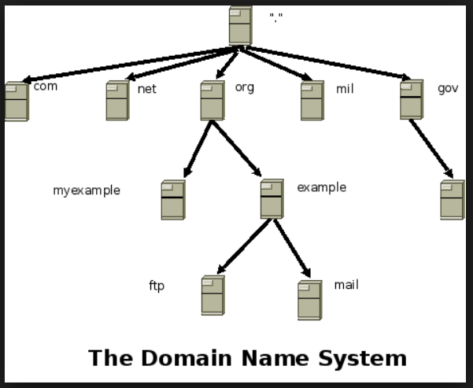
Domain Name System
How DNS works?
If we type in www.myexample.com in browser . The browser will contact a DNS server to get the IP against the name.
A DNS server would start its search for an IP address by contacting one of the root DNS servers.
The root servers know the IP addresses for all of the DNS servers that handle the top-level domains (.COM, .NET, .ORG, etc.).
DNS server would ask the root for www.myexample.com , and the root would
say, "I don't know the IP address for www.myexample.com , but here's the IP
Address for the .COM DNS server.”

Slide 24
Domain Name System
Domain Name System
Your name server then sends a query to the .COM DNS server asking it if it knows the IP address for www.myexample.com . The DNS server for the COM domain knows the IP addresses for the name servers handling the www.myexmaple.com domain, so it returns those.
Your name server then contacts the DNS server for www.myexample.com and asks if it knows the IP address for www.myexample.com. It actually does, so it returns the IP address to your DNS server, which returns it to the browser, which can then contact the server for www.myexample.com to get a Web page.
There are multiple DNS servers to resolve the request hence its very redundant. If one server fails then other takes over as authoritative to resolve the DNS query.
DNS server caches the request and hence for similar request it uses its cache to resolve the name rather than going through the complete process.

